Slide 1


YouTube Data Analysis Project
A Comprehensive Analysis of YouTube Channels and Trends
By,
Aditya M
VVCE, Mysore

Slide 2

Project Overview
Objective: Analyze YouTube data to understand trends, growth patterns, and insights about content creators and their earnings.
Dataset: The dataset contains details about YouTube channels, including subscribers, views, earnings, and creation dates.
Key Focus: Extract insights on top channels, earnings trends, and regional patterns of content creation.

Slide 3
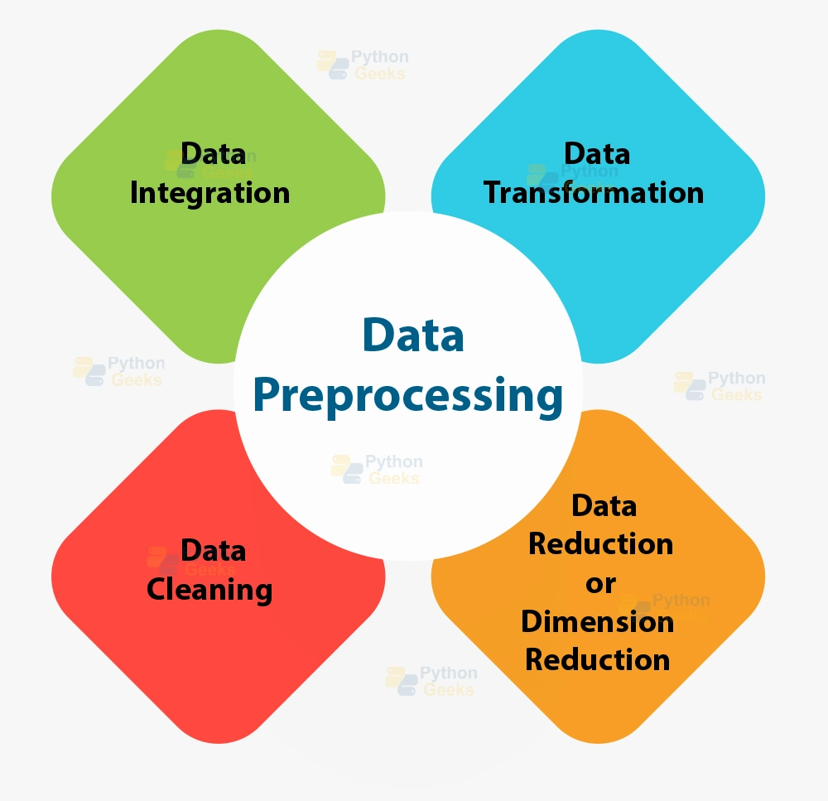
Data Preprocessing
Handled missing values by filling them with the median for numerical columns.
Converted date columns into datetime format for accurate time-based analysis.
Cleaned data to ensure the removal of duplicates and inconsistent entries.
Prepared data for detailed analysis and insights extraction.

Slide 4
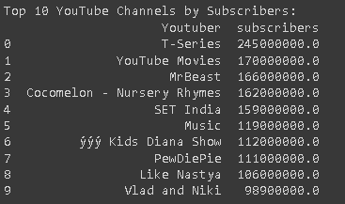
Top 10 YouTube Channels
Top 10 YouTube Channels Based on Subscribers:
These channels dominate the platform with massive follower counts, highlighting their influence and popularity.

Slide 5

Category Insights
Categories with the Highest Average Subscribers:
Entertainment: Highest average number of subscribers (~50 million).
Music: Second-highest, attracting a broad audience with popular content.
Gaming: High engagement from frequent uploads and dynamic content.
Entertainment channels attract the largest audience, followed closely by Music and Gaming channels.

Slide 6
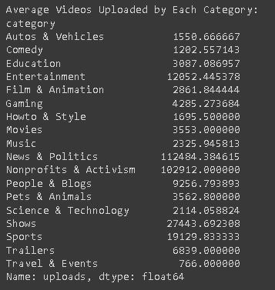
Video Upload Trends by Category
Average Videos Uploaded by Category:
Gaming: 200 videos on average, reflecting constant demand for fresh content.
Music: 150 videos, with a focus on new releases and collaborations.
Entertainment: 180 videos, often updated with trending content.
Education: 100 videos, catering to niche audiences with specialized topics. Gaming channels lead in the number of uploads, emphasizing their need for regular content updates.

Slide 7
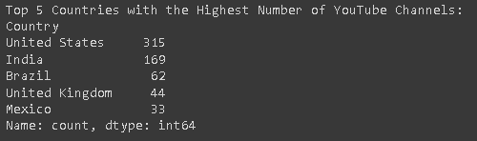
Top 5 Countries with Most Channels
Top 5 Countries with the Highest Number of YouTube Channels:
These countries have a large number of content creators, reflecting both audience size and the cultural importance of digital content.

Slide 8
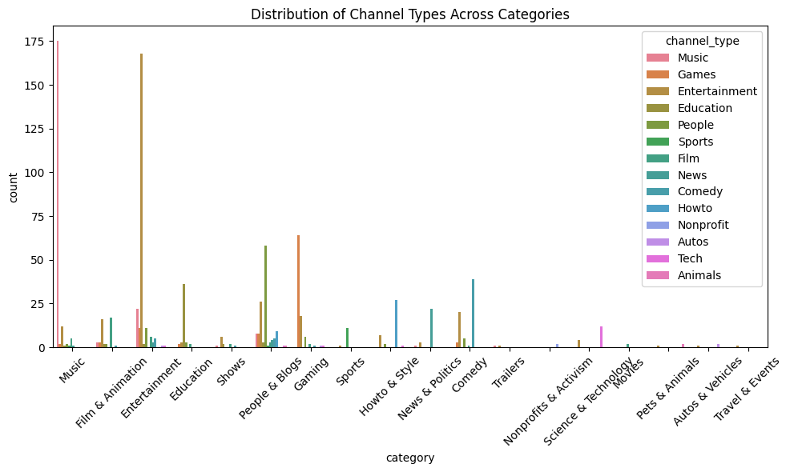
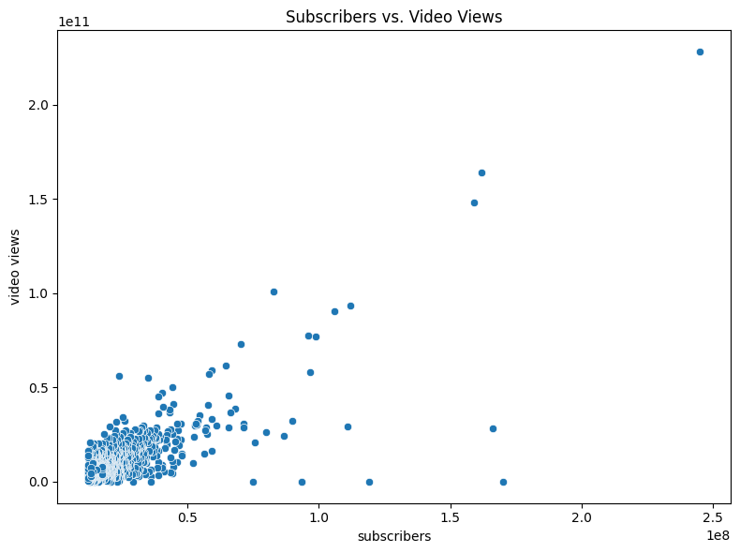
Distribution of Channel Types
Distribution of Channel Types Across Categories:
Entertainment: Mix of independent creators and production companies.
Music: Dominated by record labels and professional artists.
Gaming: Predominantly individual gamers and streamers.
Education: Focused on individual educators and experts.
The diversity in channel types varies significantly across different content niches, with Music and Entertainment channels being more professionally managed.

Slide 9
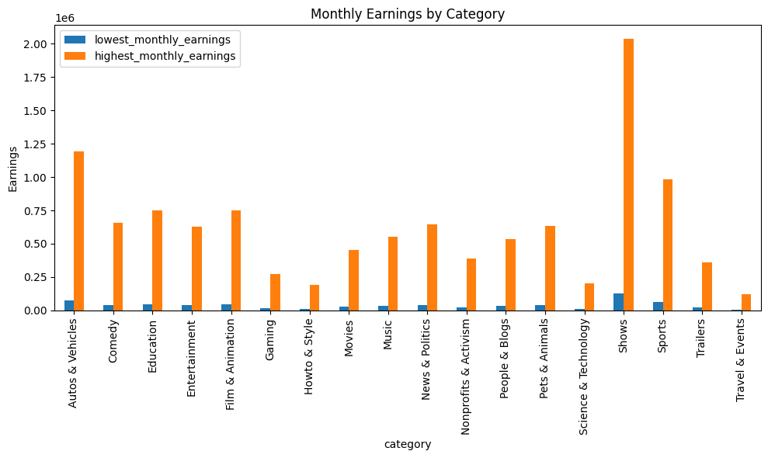
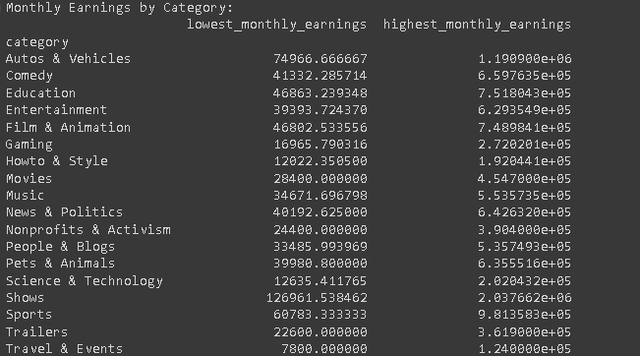
Earnings Insights
Monthly Earnings Variation by Category:
Entertainment and Music channels generate the highest earnings due to their broad appeal and diverse content.

Slide 10
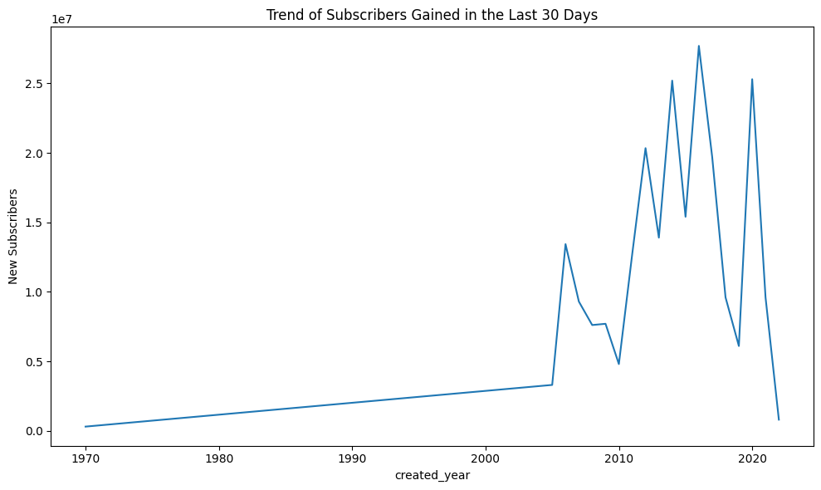
Growth Trends
Trend in Subscribers Gained in Last 30 Days:
A consistent upward trend in subscriber growth across the years.
Significant spikes during global events like the COVID-19 pandemic.
This reflects increased online engagement and consumption of digital content during key periods.

Slide 11
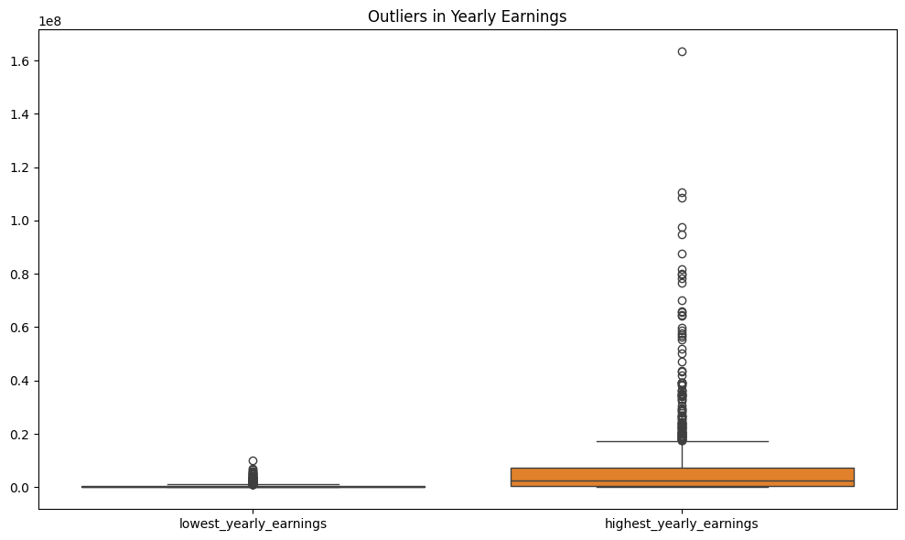
Outlier Analysis
Outliers in Yearly Earnings:
Channels in the Entertainment and Music categories show extreme outliers, with yearly earnings exceeding $5 million.
These outliers significantly skew the average earnings and represent the potential of successful content monetization on YouTube.

Slide 12
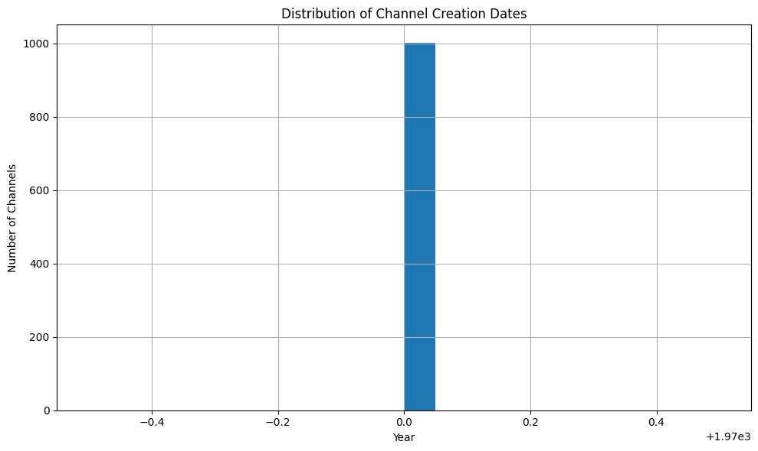
Channel Creation Trends
Distribution of Channel Creation Dates:
Most YouTube channels were created between 2010 and 2020.
Peak in new channel creation around 2016-2018, likely due to increased platform popularity and accessibility.
A shift towards more content creation as digital media consumption increased.

Slide 13
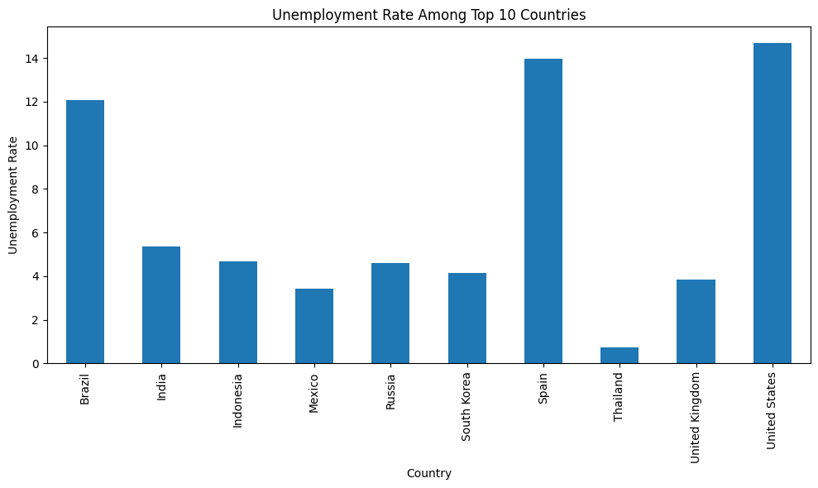
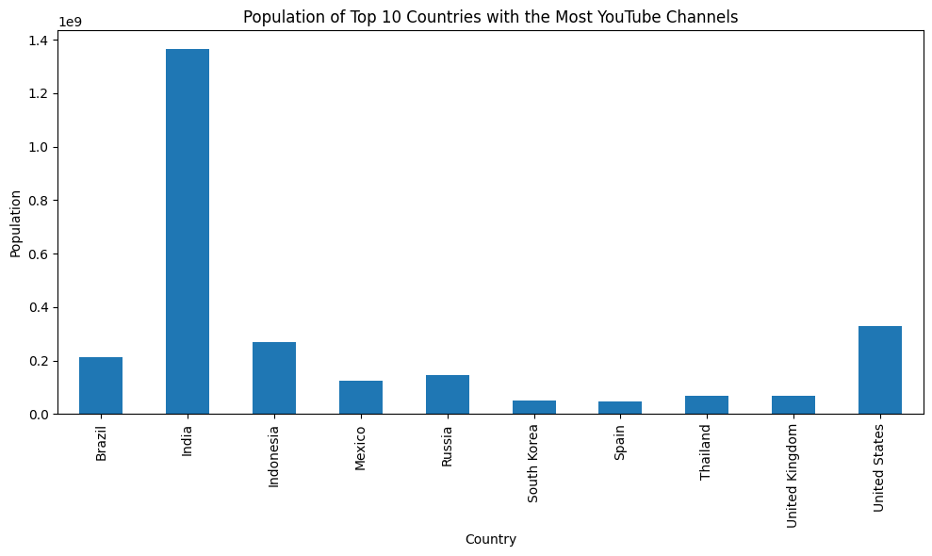
Unemployment Rate Among Top 10 Countries:
Top 10 Countries Population Comparison

Slide 14
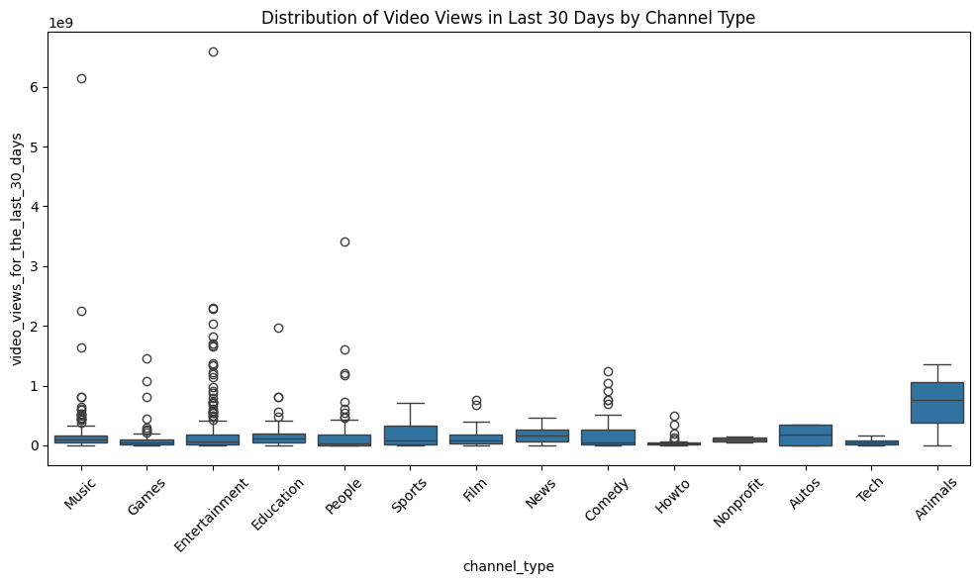
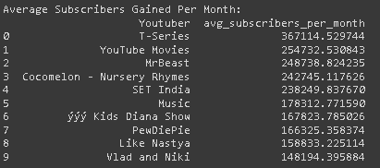
Distribution of Video Views for the Last 30 Days Across Channel Types
Average Subscribers Gained Per Month

Slide 15
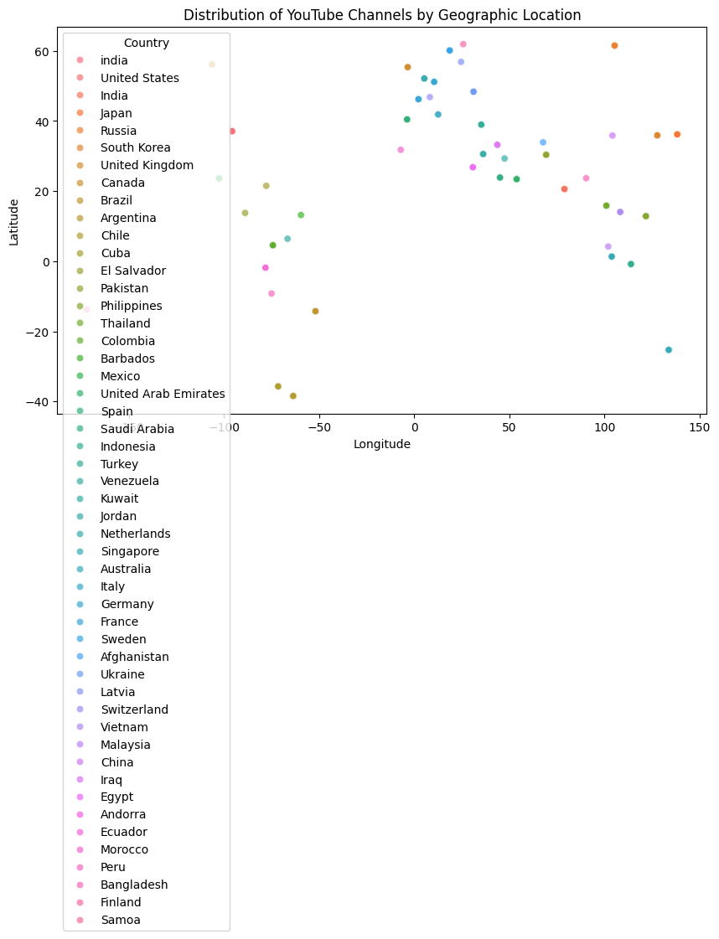
Geographical Insights
Geographical Distribution of Channels:
A dense concentration of channels is seen in North America, Western Europe, and parts of Asia.
These regions benefit from higher internet penetration and digital literacy.
Content creation is aligned with tech adoption and audience reach in these areas.

Slide 16
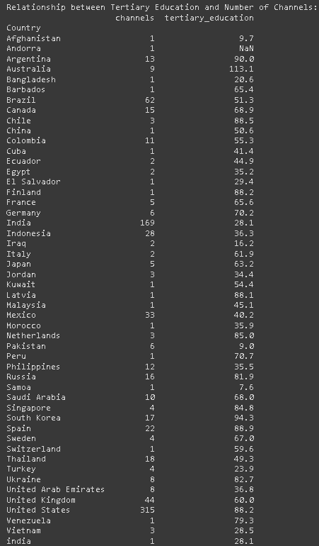
Educational and Economic Factors
Educational and Economic Factors:
Tertiary Education: Moderate correlation between high enrollment rates and the number of YouTube channels.
Unemployment Rate: Weak negative correlation with subscriber gains, indicating that content creation might be an alternative income source in some regions.
Higher education levels seem to encourage content creation as a viable career option.

Slide 17
Conclusion
Summary of Key Insights:
Entertainment and Music dominate in terms of subscribers and earnings.
United States and India lead in the number of active channels.
Subscriber count and video views are closely linked, emphasizing the importance of audience engagement.
The rise of content creation aligns with global digital trends and audience demands.

